Slide 1

Artificial Intelligence and ChatGPT in Education
Torrance Smith
Sam Houston State University
CIED 5383: INTEGRATING CURRENT TECHNOLOGY IN TEACHING

Slide 2
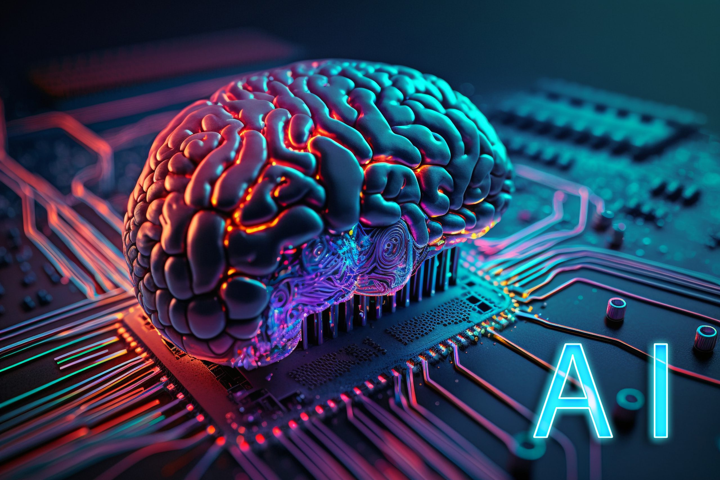
How can AI enhance the learning experience in higher education?
Providing personalized support to students.
AI adapts learning materials to match each student’s pace and understanding.
Intelligent tutoring systems can guide students through difficult topics and give instant feedback. T
his allows students to focus on areas where they need the most help.

Slide 3
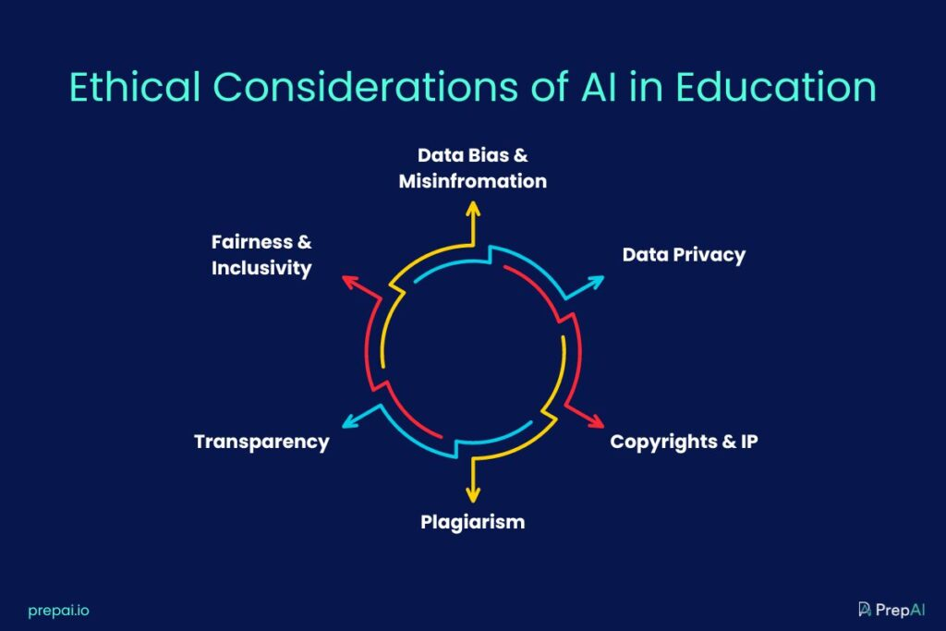
Are there any concerns or ethical considerations regarding AI in education?
One concern is the ethical use of AI.
AI systems collect and analyze student data, raising privacy issues.
Bias in AI algorithms is also a risk if training data is not diverse.
Educators must ensure AI is used responsibly and that student information is protected.

Slide 4
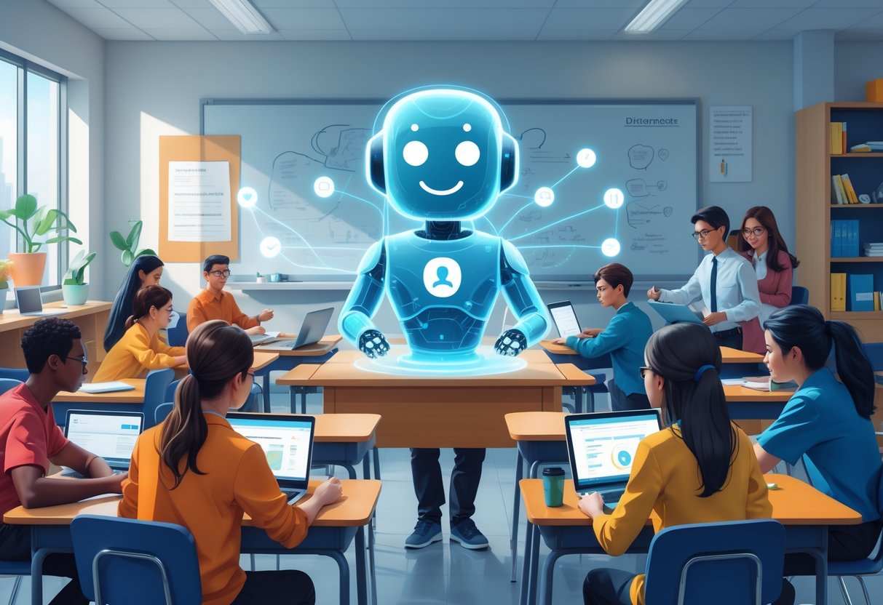
What are the potential benefits of incorporating AI and ChatGPT into teaching?
AI and ChatGPT save time for educators and provide additional support for students.
AI can automate grading for objective assessments and generate practice exercises.
ChatGPT helps students understand complex concepts and provides examples in real time.
This allows teachers to focus on interactive and critical thinking activities.

Slide 5

Can AI or ChatGPT personalize education for students?
AI can personalize education by identifying strengths and weaknesses and adjusting content accordingly.
Adaptive learning platforms can increase difficulty when a student is doing well or provide additional practice if a student is struggling.
Personalization improves learning outcomes and helps students stay motivated.

Slide 6
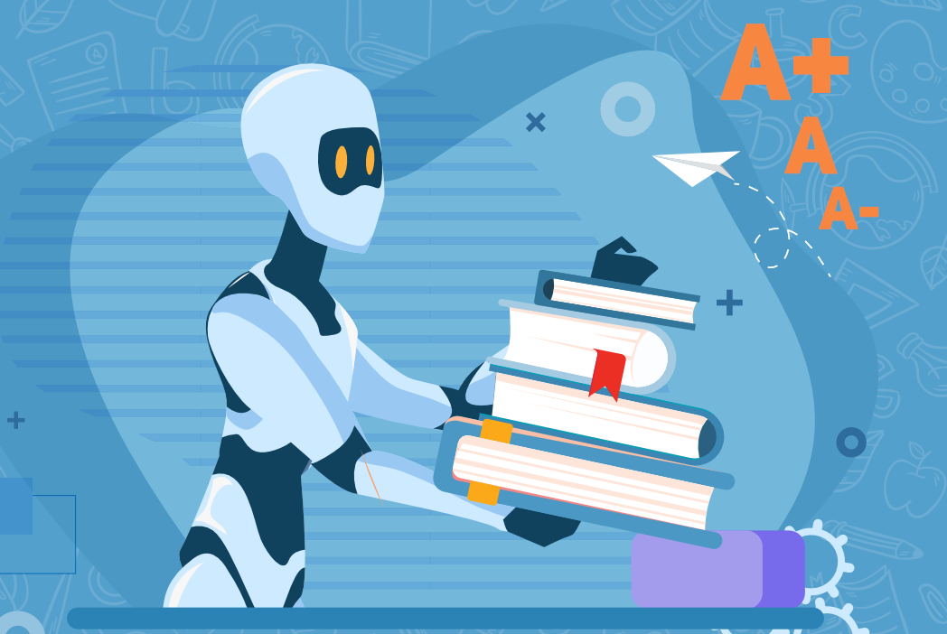
In which subjects could AI be particularly useful?
AI is useful in subjects that require repeated practice or complex problem-solving, such as mathematics and language learning.
AI systems provide instant feedback and additional exercises.
For language learners, ChatGPT can simulate conversations to improve communication skills without pressure from a human teacher.

Slide 7
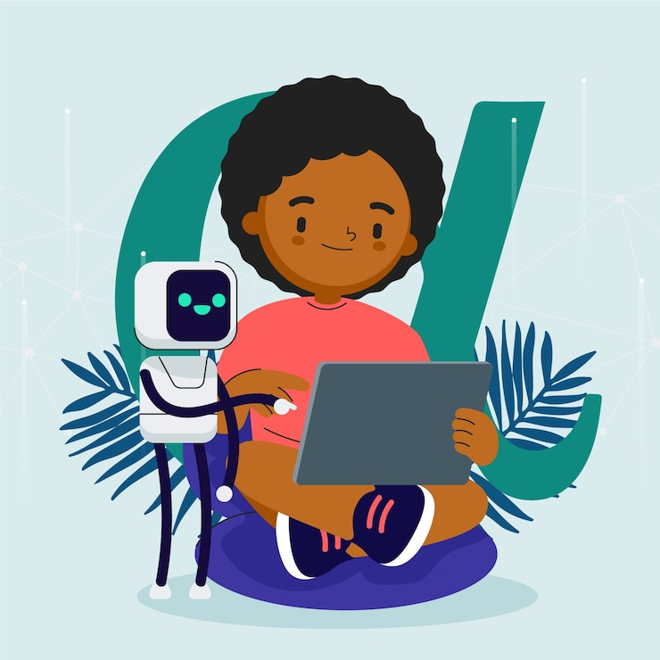
What AI-related skills should universities teach students?
Universities should teach skills such as understanding how AI works, data ethics, and using AI tools effectively.
These skills prepare students for a future where AI is integrated into many professional fields.
Understanding AI also helps students critically evaluate AI-generated information and use it responsibly

Slide 8

Conclusion
AI and ChatGPT offer many advantages for education but ethical concerns must be addressed.
AI should complement traditional teaching methods rather than replace human interaction.
Universities have a responsibility to prepare students to use AI thoughtfully and responsibly.

Slide 9
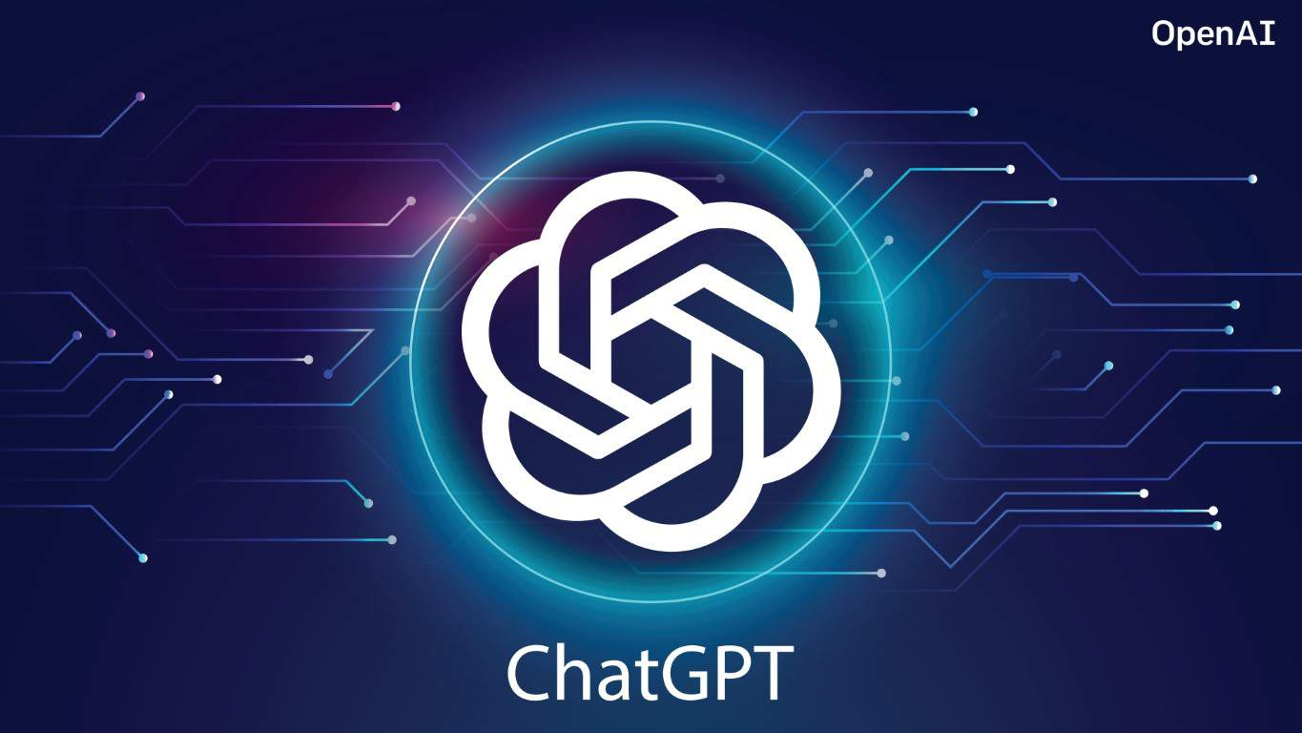
Thank You

